Slide 1
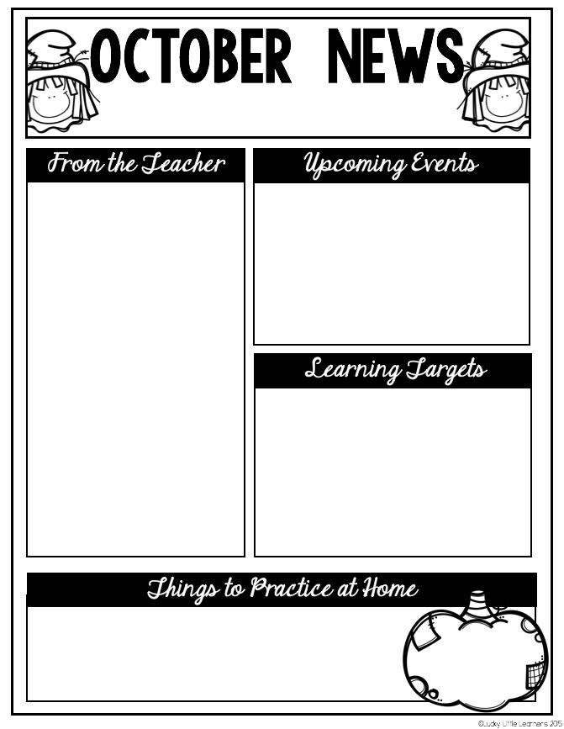
Summit Hill First Grade
2021
Curriculum Focus
The Leader in Me
Math: We will continue to work on understanding the attributes of plane and solid shapes. We will learn that fractions are equal parts of a whole and will focus on halves and fourths. We will use bar graphs to represent and interpret information.
Reading: This month we will work hard to earn our Word Detective Badges! We will notice a problem and stop to solve it. We will look CLOSELY at words from start to end and we will use everything we know to figure out those tricky words. Students will continue to work on stamina and setting goals each day.
Writer’s Workshop: This month we will switch to informational writing. We will write “how to” pieces telling what to do in steps. We will use pictures that teach the reader and we will give warnings, suggestions and tips.
SS/Science: We will continue our study of the weather and seasons. Then we will start learning about the life of Benjamin Franklin and how he helped our country.
We are working on habit # 2:
Begin With the End in Mind: Have A Plan!
I plan ahead and set goals. I do things that have meaning and make a difference. I am an important part of my classroom and contribute to my school’s mission and vision. I look for ways to be a good citizen.
Upcoming Events
10/ 8 First Quarter Report Cards
10/11 Columbus Day: No School
10/12 Teacher Work Day: No School
10/13 Picture Day Make -Ups
10/12-10/22 Fall Conferences (virtual)
10/29 Book Character Parade
- counting by 5s and 10s to 120
- addition facts to 10 (3 second recall)
- think of ways habit 2 can help you at home
- learn your address and phone number

