Slide 1
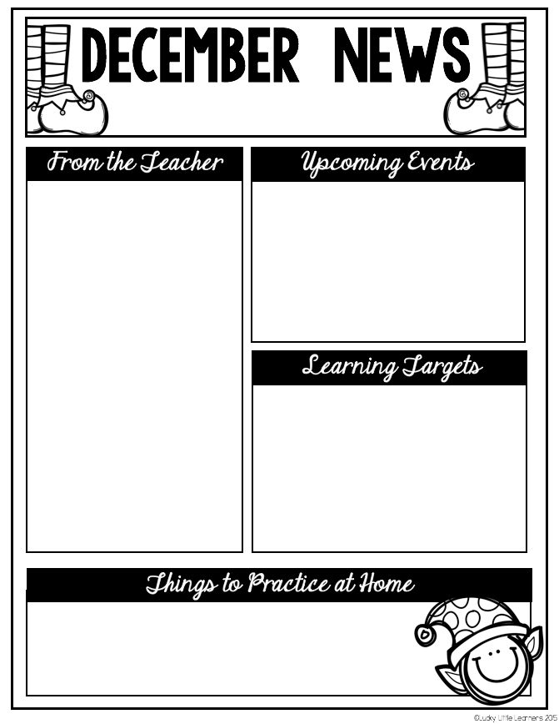
Summit Hill First Grade
Curriculum Focus
The Leader in Me
Math: We will finish our unit on measurement and time. We will begin reviewing strategies for addition and subtraction to prepare for our upcoming unit.
Reading: We will finish our unit on non-fiction books. We will practice reading our non-fiction texts like an expert by marking interesting parts and reading with expression. We will finish practicing our beginning blends. (r, l, s, and w)
Writing: We will celebrate the end of our informational writing unit by choosing one book to share with the class.
Social Studies: We will continue to learn about the explorers Lewis and Clark. Then we will learn about Thomas Jefferson and how he helped to make our country better.
Habit # 4 :Think Win- Win
Everyone can win! I balance courage for getting what I want with consideration for what others want. When conflicts arise, I look for third alternatives.
Upcoming Events
12/15 | Holiday Party
12/16 | Vision Screening
12/20-12/31 | Winter Break
1/3 | Work Day/No School
* Practice reading with fluency and expression to
someone at home.
* Practice addition and subtraction facts to 20.

